Slide 1
The brotherhood
Notes:
It goes back to the slide that a lot of these veterans feel the emptiness when they get out.
so, they feel the isolation kick in and then the avoidance comes in and it’s a slippery slope.
PTSD can't fix itself and if they have it, they need to work with someone.
If we know the people are out there before the crisis and we can get them in just to get to one VA contact that is a great first step for a lot of people.
Despite the hardships that they endured, the injuries that they sustained and the loss of personal freedom that they experienced most veterans would agree with the paradoxical statement that they are glad that they are no longer serving yet they would do it all again if given the chance.

Slide 2
Invisible Wounds
Combat can cause invisible wounds to the brain, mind, and soul
Traumatic Brain Injury (TBI)
Post Traumatic Stress Disorder (PTSD)
Both types of injuries can lead to
Poor judgment
Impulsivity
Difficulty in matching behavior to the context
Behaviors attributable to these injuries
Can look like criminal behavior
Can be criminal
Routine Post Deployment -VS- PTSD/TBI
Adjustment

Slide 3
Veterans Justice Program Initiative
“The purpose of the VJO Initiative is to avoid unnecessary criminalization of mental illness and extended incarceration among Veterans by ensuring that eligible Veterans in contact with the criminal justice system have access to:
VHA mental health and substance abuse services when clinically indicated , and other VA services and benefits as appropriate.”
Department of Veteran Affairs, April 30, 2009, Under Secretary for Health’s Information Letter

Slide 4
Justice-Involved Veterans
More than half have either mental health problems (PTSD, depression, anxiety) or Substance Use Disorders
In 2018 – 180,000 incarcerated Veterans in MA
-SUD was #1 factor for arrest
-Symptoms of PTSD was #2 factor for arrest (anger/irritability)
Veterans are more likely to be sentenced for violent offences
Approx. 9% of veterans returning from Iraq and Afghanistan have been arrested since returning
Outcomes when Veterans in the courts receive VA care
88% reduction in arrests (year post- vs. year pre-court participation)
30% increase in stable housing (from baseline to year post-court participation)
Notes:
The reason I have been talking to you about all this is……We know that…. more than half of the Veterans involved with the criminal justice system have a problem with mental health and/or addiction.
-Every VA has someone who does what Sarah and myself do so it is important to get them connected with us so we can get them help early and identify resources that are available to them.
-Statistically speaking when a veteran in the courts get involved in VA care, we see an 88% reduction in future arrests and a 30% increase in stable housing. We have a whole program that is set aside to help our veterans seek housing

Slide 5
What can a VJO/HCRV Specialist do?
Facilitate access to VA services at the earliest possible point in the Veteran’s criminal justice involvement
Assist local partners in identifying Veterans and determining eligibility for VHA services
Conduct outreach, assessment and case management for Veterans engaged with law enforcement and the judicial system
Training for law enforcement and judicial staff
Referrals for VA and community-based services/resources

Slide 6
VA Enrollment
DD214 (www.archives.gov)
1010EZ-enrollment document
Online, Paper, VA clinic, phone
National Enrollment-877-222-8387
https://www.va.gov/HEALTHBENEFITS/apply/
Factors considered include length of service and discharge (September 8, 1980)
VA eligibility and enrollment office determines eligibility
Service Connection
Disease/injury incurred during military service
Compensation benefits may be paid
Notes:
DD214-military service record that enrollment may request.
1010EZ is official enrollment request paperwork. Enrollment generally processes within a few days.
Link provided but if you google VA 1010EZ or VA enrollment the link will also appear.
Length of service: 1 day active duty prior to 9/8/1980 and 2 years post. Other exceptions, National Guard under article 10 etc.
OTH discharge (eligible GPD only).
Other types: Honorable, General Under Honorable, Medical, Bad Conduct, Dishonorable
Advice to always complete enrollment paperwork and see enrollments reply.
**Service Connection-If 0% only treated for that specific condition. If 10% or more eligible for all VA healthcare even if otherwise ineligible.

Slide 7
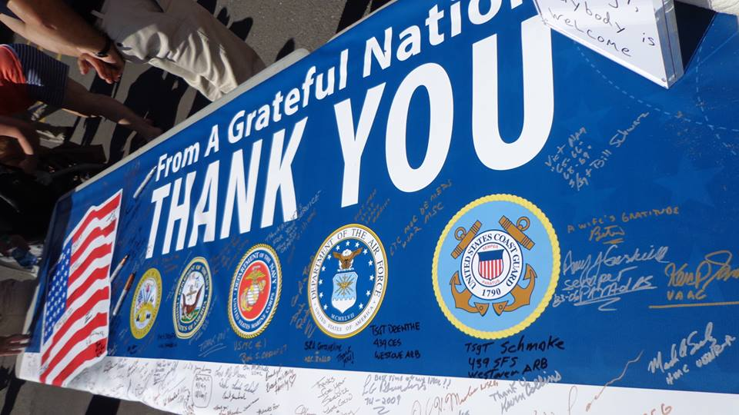
The Brave Act

Slide 8
Veteran Treatment Courts
Western Mass Veterans Treatment Court
Gardner Veterans Treatment Court
Notes:
8

Slide 9
How can law enforcement help?
Ask Veteran “Have you served in the US military?”
Once you’ve established Veteran status, ask if person is being seen at any VA
If they are, ask if they have a safety plan and if they have someone they want to call from the plan
Lower Radio
Active listening skills
Softer / slower voice / be careful of tone / avoid sarcasm
Ask open-ended questions (“what, how, when – avoid why”)
Effective pauses
Re-state/recap what they have said
Grounding - Get them in the present
Do not overcrowd Veteran. Give some space
Keep them informed of steps along the way
Notes:
This isn’t telling you anything you don’t know.
US military
Lower radio –tbi
Effective pauses-tbi
Re-state- tbi
Grounding –PTSD/TBI
Overcrowd –PTSD bath in adrenaline, crisis mode

Slide 10
Goals of intervention
Restoring the Veteran to baseline level of functioning, not of personality changes.
Attempt to mobilize the veteran’s internal and external resources.
Stay cognitive, not emotional to maintain control of the situation.
The Arc of a Crisis
3
When behaviors reach there max, we call this state the crisis zone, because the higher functioning parts of the brain are off-line.
2
4
Something triggers strong emotions, after which escalation behaviors increase.
After de-escalating the person will naturally begin to calm down over time.
1
CRISIS
ZONE
At first there’s no distress though there may be some pre-disposition.
5
Eventually, the brain and body return to the baseline.
Escalation
De-escalation
Level of distress
Return to Baseline
Baseline
Time

Slide 11
